Slide 1


CSCI 363 - Artificial Intelligence (Fall 2024)
Lecture 2
Agents and Uninformed Search
Prof. Jonathan Gryak
Department of Computer Science
Queens College, CUNY
Sources: J. Gryak (CUNY), D. Klein and P. Abbeel (UC Berkeley, ai.berkeley.edu), Pearson Education

Slide 2
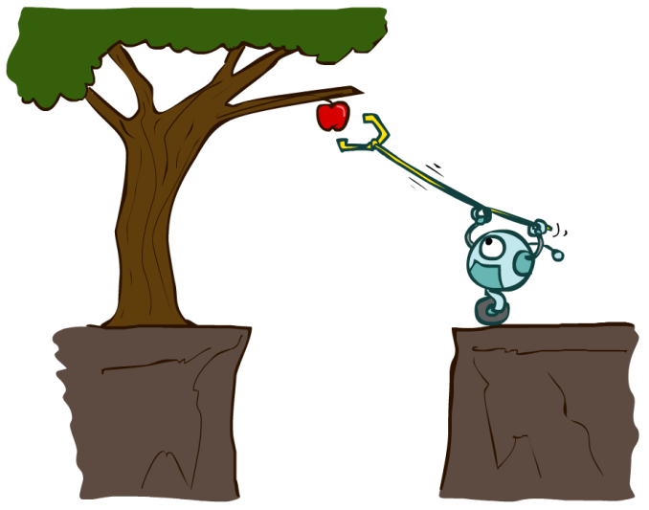
Designing Rational Agents
An agent is an entity that perceives and acts.
A rational agent selects actions that maximize its (expected) utility.
Characteristics of the percepts, environment, and action space dictate techniques for selecting rational actions
Sensors
Agent
Percepts
Environment
?
Actuators
Actions

Slide 3
Designing Rational Agents (cont.)
Environments vary based on:
(Full) Observability: Sensors provide agent with all relevant information
Number of agents: Are their other intelligent agents to contend with?
Determinism: The next state is wholly determined by the current state and an agent’s action
Dynamism: Does the environment change while the agent is making a decision?
Episodic vs. sequential tasks
Discrete vs. continuous states
Sensors
Agent
Percepts
Environment
?
Actuators
Actions

Slide 4
Agent Environment: Autonomous Taxi
Environment | AV Taxi
Performance (Utility) Measures | Safe travel, fast routes, legal driving, maximize profit
Environment | Roads, signs, lights, buildings, pedestrians, passengers, weather
Sensors | Cameras, LIDAR, seat sensors, GPS, engine, microphones, touchscreen
Percepts | Color images, object distance, pressure, lat/long, fuel level, speech, commands
Actuators | Steering, accelerator, brakes, signal, display, speech
Actions | Turn left, speed up, slow down, show fare, inform passenger of ETA

Slide 5
Environment Properties
Environment/Task | Cancer Diagnosis | Image Classification
Observability | Partial | Full
# of Agents | Single | Single
Determinism | Stochastic | Deterministic
Dynamism | Dynamic | Static
Episodicity | Either | Episodic
Discrete? | Continuous | Continuous

Slide 6
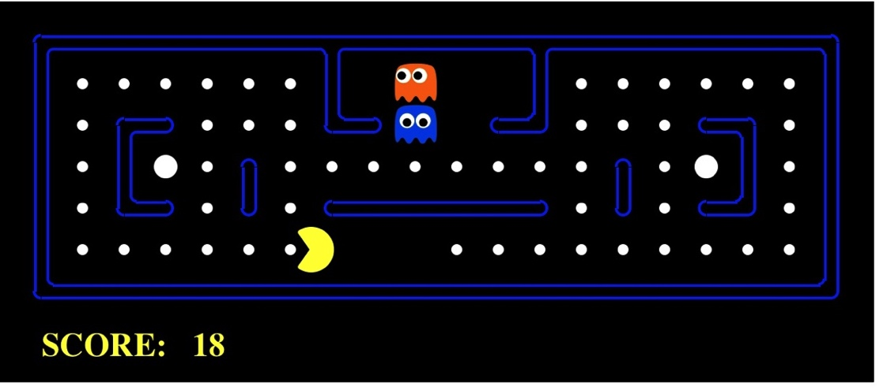
Pac-Man as an Agent
Agent
Environment
Sensors
Percepts
?
Actuators
Actions
Pac-Man is a registered trademark of Namco-Bandai Games, used here for educational purposes

Slide 7

Pac-Man as an Agent

Slide 8
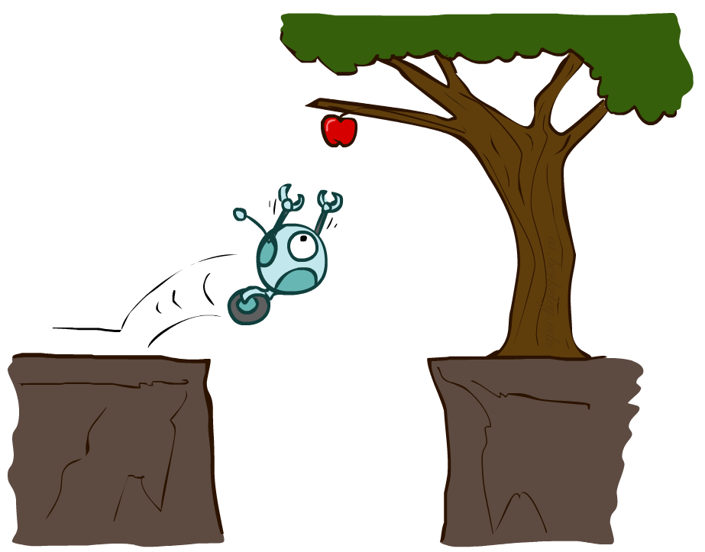
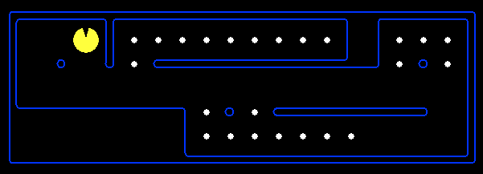
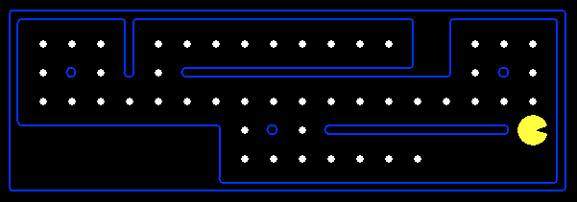
Reflex Agents
Reflex agents choose actions based on the current precept
May additionally have memory (internal state) and/or a model of the environment’s current state
Do not consider the future consequences of their actions
Consider how the world IS
Can a reflex agent be rational?

Slide 9
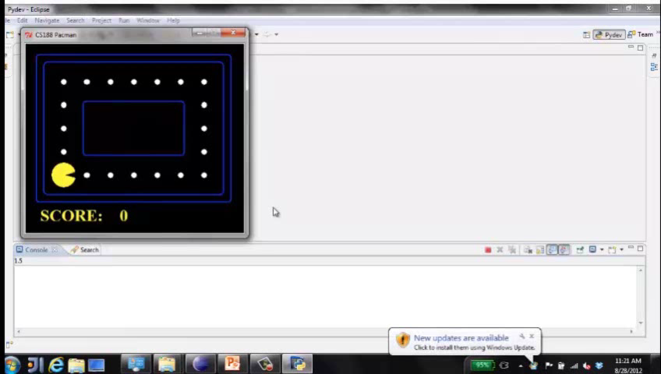
Pac-Man: Reflex Agent 1

Slide 10
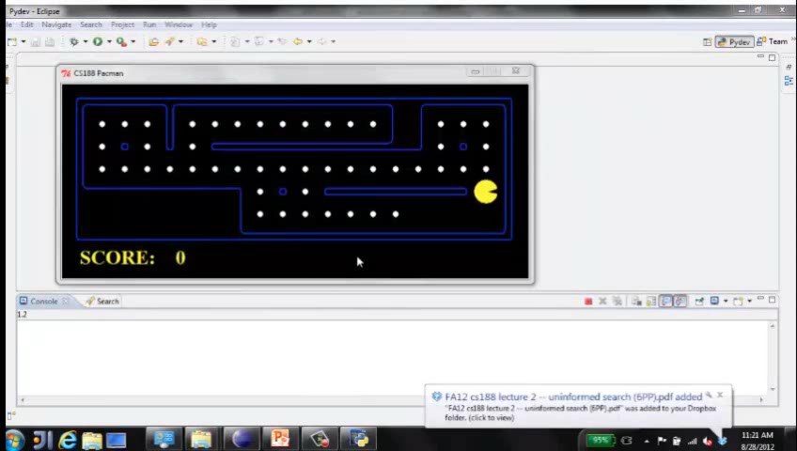
Pac-Man: Reflex Agent 2

Slide 11
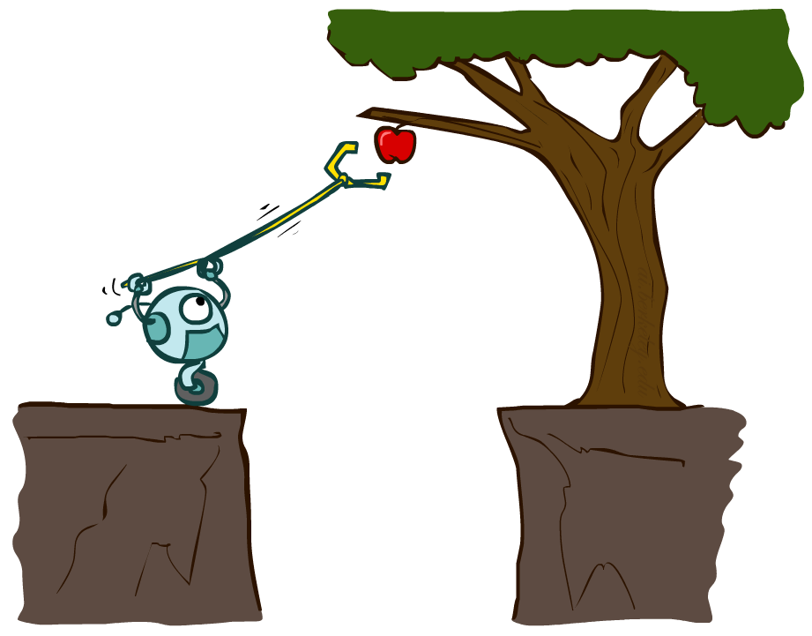
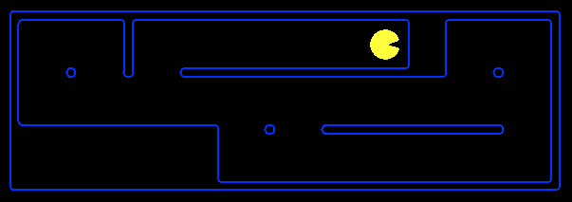
Planning Agents
Planning agents make decisions based on (hypothesized, i.e., not via experience) consequences of actions
Must have a model of how the world evolves in response to actions
Must formulate a goal (test) and may use a utility (scoring) function to determine the best current action to take
Consider how the world WOULD BE
If the goal can’t be reached in a single move, one can:
Search
Plan

Slide 12
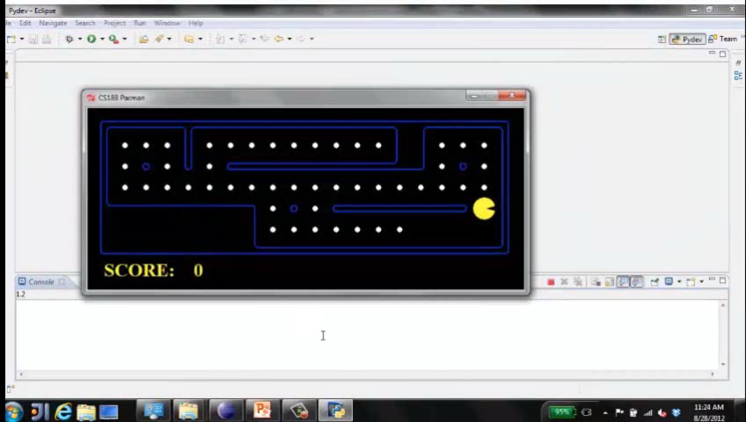
Pac-Man: Planning Agent

Slide 13

Search Problems

Slide 14

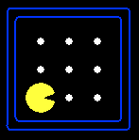





Search Problems
A search problem consists of:
A state space
A successor function
(with actions, costs)
A start state and a goal test
A solution is a sequence of actions (a plan) which transforms the start state to a goal state
“N”, 1.0
“E”, 1.0

Slide 15
Example: Traveling in Romania
State space:
Cities
Successor function:
Roads: Go to adjacent city with cost = distance
Start state:
Arad
Goal test:
Is state == Bucharest?
Solution?

Slide 16
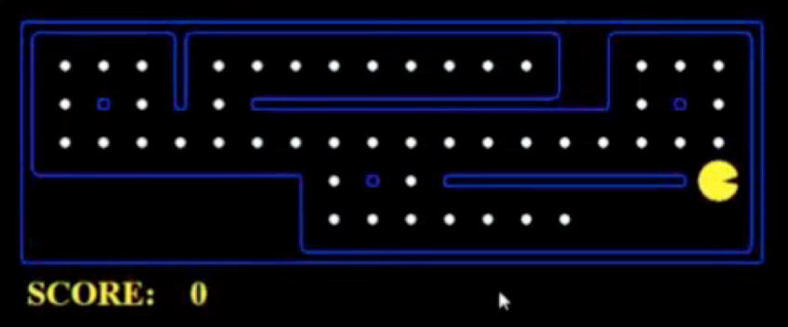
What’s in a State Space?
The world state includes every last detail of the environment.
A search state keeps only the details needed for solving a specific problem.
Problem: Path to Destination
States: (x,y) location
Actions: NSEW
Successor: update location only
Goal test: is (x,y)=END
Problem: Eat All Food
States: {(x,y), food Booleans}
Actions: NSEW
Successor: update location and a Boolean food hash table
Goal test: food all false

Slide 17
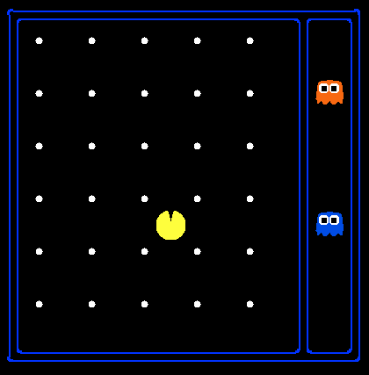
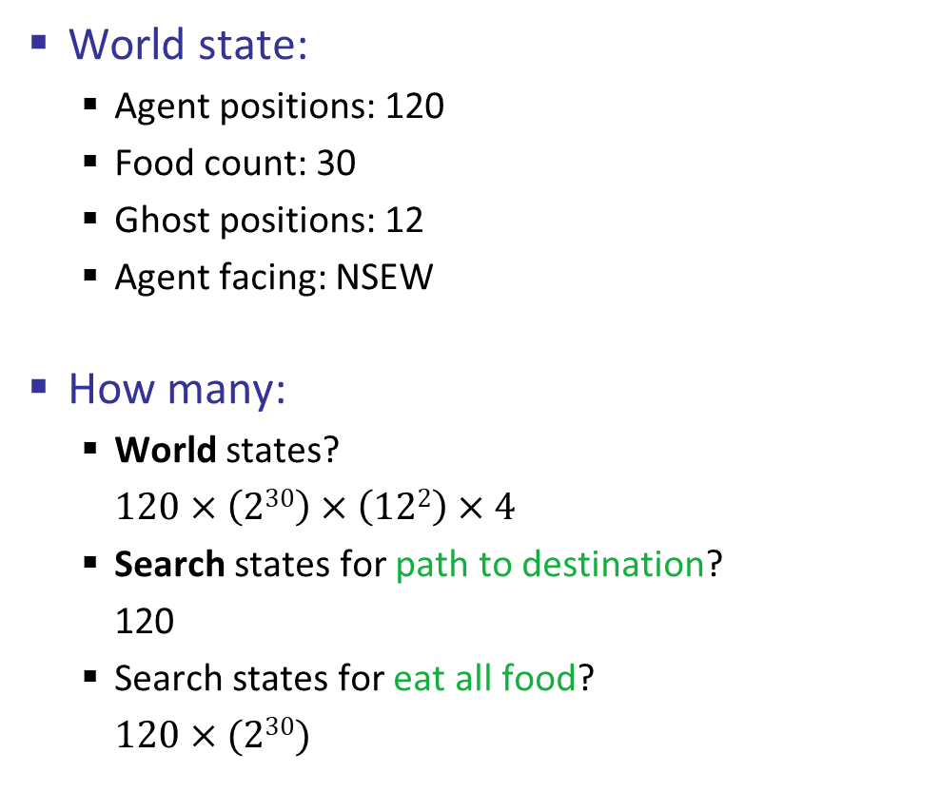
State Space Sizes
World state:
Agent positions: 120
Food count: 30
Ghost positions: 12
Agent facing: NSEW
How many:
World states?
$120×\left(230\right)×\left(122\right)×4$
Search states for path to destination?
120
Search states for eat all food?
$120×(230)$
10
1
12
Notes:
90 * (2^30-1) + 30 * 2^29 = 145 billion
2^29 = 536 870 912

Slide 18
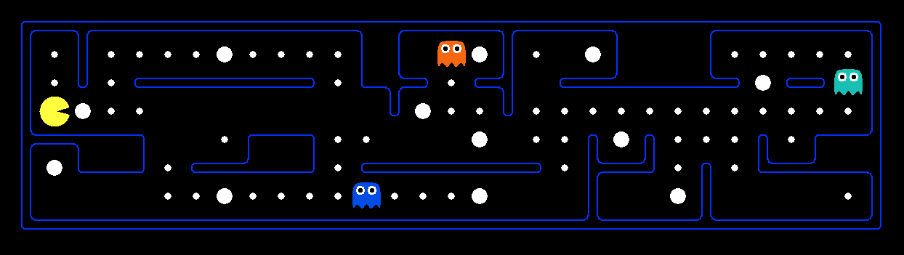
Example: Safe Passage
Problem: eat all food while keeping the ghosts permanently scared
What does the state space have to specify?
(agent position, food Booleans, power pellet Booleans, remaining scared time)

Slide 19
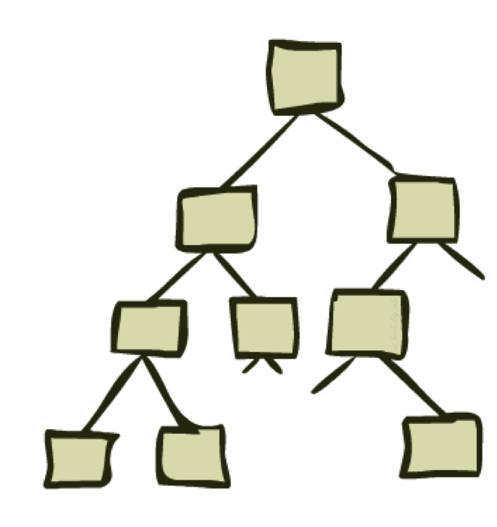
State Space Graphs and Search Trees

Slide 20
State Space Graphs
State space graph: A mathematical representation of a search problem
Nodes are (abstracted) world configurations
Arcs represent successors (action results)
The goal test is a set of goal nodes (maybe only one)
In a state space graph, each state occurs only once!
We can rarely build this full graph in memory (it’s too big), but it’s a useful idea

Slide 21
State Space Graphs
State space graph: A mathematical representation of a search problem
Nodes are (abstracted) world configurations
Arcs represent successors (action results)
The goal test is a set of goal nodes (maybe only one)
In a state space graph, each state occurs only once!
We can rarely build this full graph in memory (it’s too big), but it’s a useful idea
a
G
b
c
d
e
f
S
h
p
q
r
Tiny state space graph for a tiny search problem

Slide 22
Search Trees
This is now / start
“N”, 1.0
“E”, 1.0
Possible futures
A search tree:
A “what if” tree of plans and their outcomes
The start state is the root node
Children correspond to successors
Nodes show states, while paths correspond to plans that achieve those states
For most problems, we can never actually build the whole tree

Slide 23
State Space Graphs vs. Search Trees
State Space Graph
Search Tree
S
a
G
d
e
p
b
c
b
c
e
h
r
q
d
e
f
a
a
h
r
p
q
f
S
h
q
c
p
r
p
q
f
G
q
q
c
a
G
a
Each node in the search tree is an entire path in the state space graph.
We construct both on demand – and we construct as little as possible.

Slide 24

State Space Graphs vs. Search Trees
Consider this 4-state graph:
How big is its search tree (from S)?
a
s
a
b
S
G
b
G
a
G
b
a
G
b
G
…
…
Lots of repeated structure in the search tree!

Slide 25
Tree Search

Slide 26
Search Example: Romania

Slide 27
Searching with a Search Tree
Search:
Expand out potential plans (tree nodes)
Maintain a frontier of partial plans under consideration
Try to expand as few tree nodes as possible

Slide 28
General Tree Search
Important ideas:
Frontier
Expansion
Exploration strategy
Main question: which frontier nodes to explore?

Slide 29
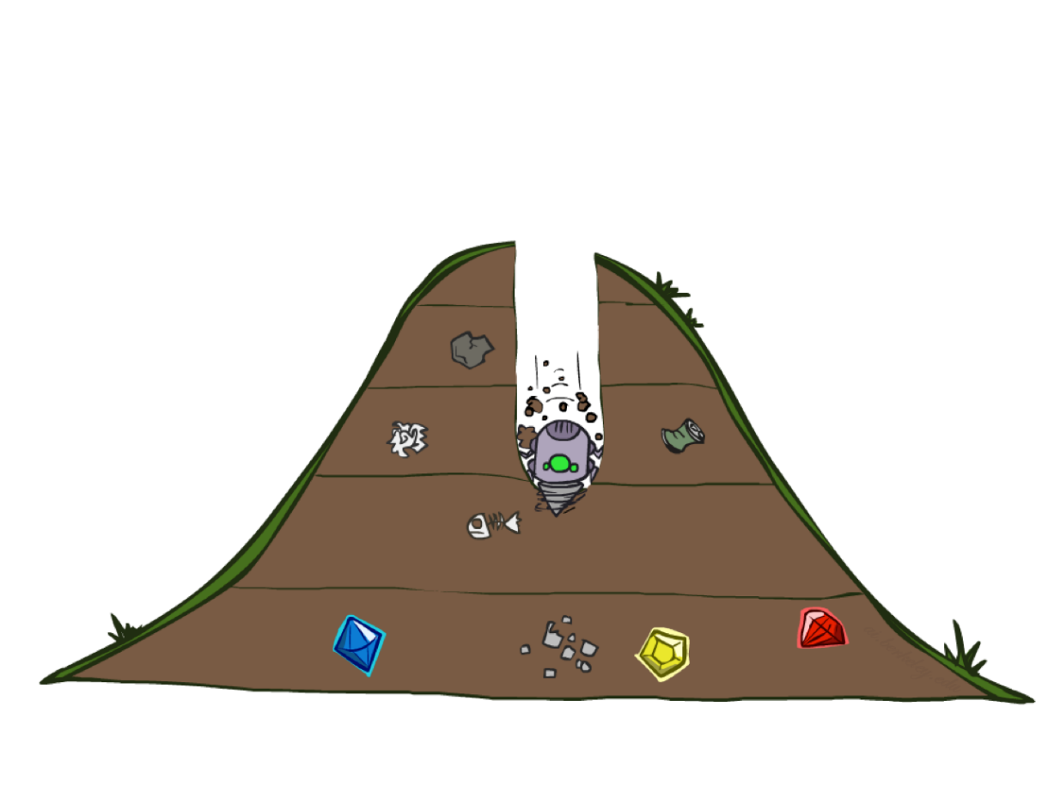
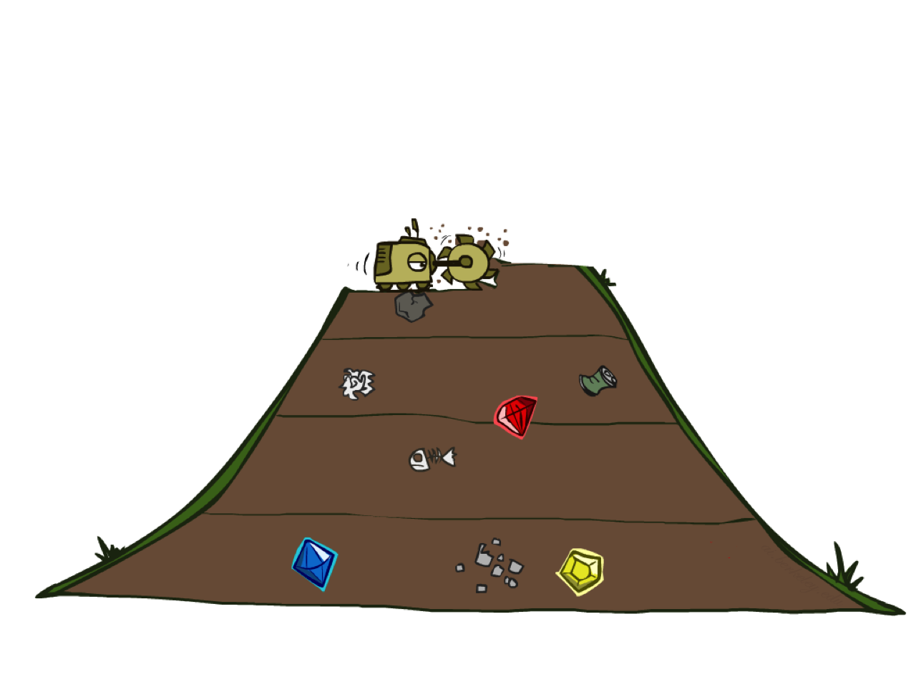
Depth-First and Breadth-First Search

Slide 30
Depth-First Search
Strategy: Expand the deepest node first
Implementation: Frontier is a LIFO stack
a
G
a
c
b
c
b
e
d
e
d
f
f
S
h
h
p
p
r
q
r
q
On Board
S
d
e
p
b
c
e
h
r
q
a
a
h
r
p
q
f
p
q
f
q
c
G
q
c
G
a
a

Slide 31
Breadth-First Search
Strategy: Expand the shallowest node first
Implementation: Frontier is a FIFO queue
a
G
b
c
d
e
f
S
h
p
q
r
On Board
S
d
e
p
Search
Tiers
b
c
e
h
r
q
a
a
h
r
p
q
f
p
q
f
q
c
G
q
c
G
a
a

Slide 32
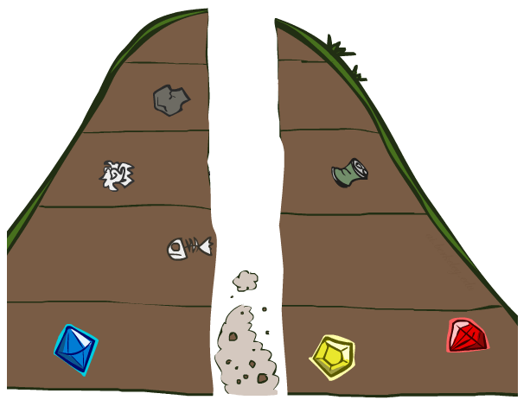
Search Algorithm Properties

Slide 33
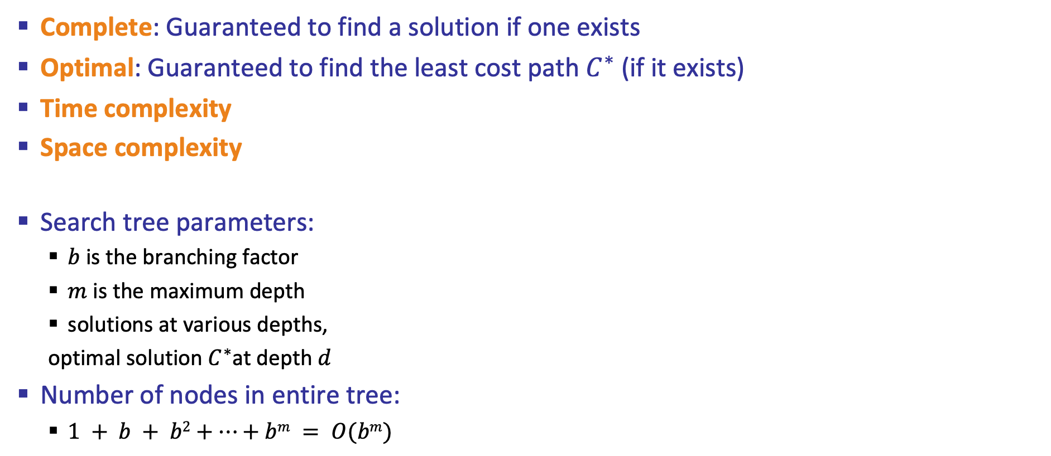
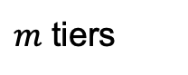
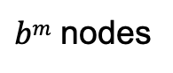
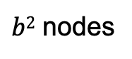
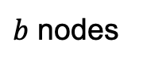
Search Algorithm Properties
Complete: Guaranteed to find a solution if one exists
Optimal: Guaranteed to find the least cost path $C^{∗}$ (if it exists)
Time complexity
Space complexity
Search tree parameters:
$b$ is the branching factor
$m$ is the maximum depth
solutions at various depths,
optimal solution $C^{∗}$at depth $d$
Number of nodes in entire tree:
$1 + b + b2+…+bm = O(bm)$
1 node
b
…
$b$ nodes
$b2$ nodes
$m$ tiers
$bm$ nodes

Slide 34
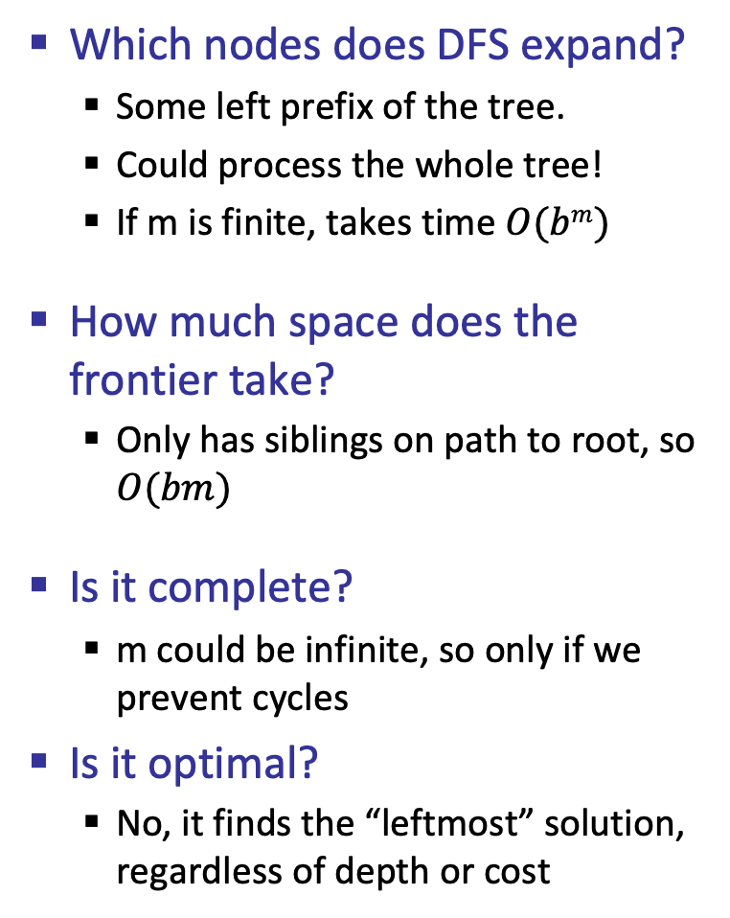
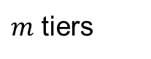
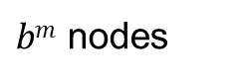
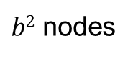
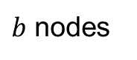
Depth-First Search (DFS) Properties
Which nodes does DFS expand?
Some left prefix of the tree.
Could process the whole tree!
If m is finite, takes time $O(bm)$
How much space does the frontier take?
Only has siblings on path to root, so $O(bm)$
Is it complete?
m could be infinite, so only if we prevent cycles
Is it optimal?
No, it finds the “leftmost” solution, regardless of depth or cost
1 node
b
…
$b$ nodes
$b2$ nodes
$m$ tiers
$bm$ nodes

Slide 35
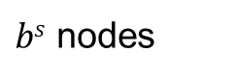
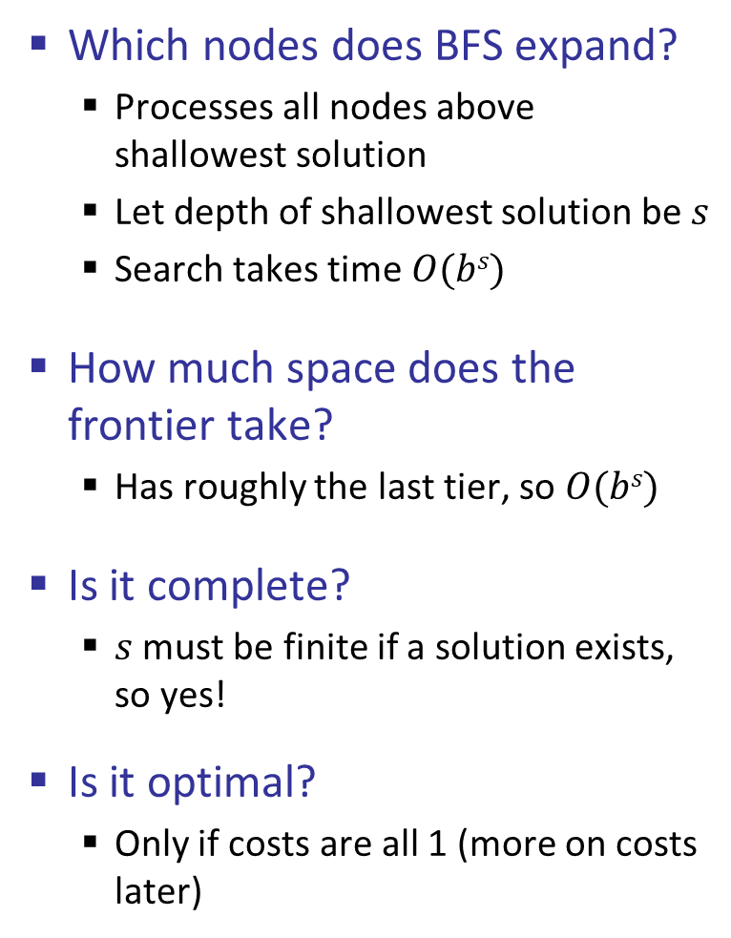

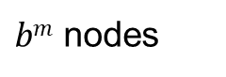
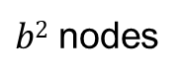
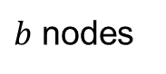
Breadth-First Search (BFS) Properties
Which nodes does BFS expand?
Processes all nodes above shallowest solution
Let depth of shallowest solution be $s$
Search takes time $O(bs)$
How much space does the frontier take?
Has roughly the last tier, so $O(bs)$
Is it complete?
$s$ must be finite if a solution exists, so yes!
Is it optimal?
Only if costs are all 1 (more on costs later)
1 node
b
…
$b$ nodes
$s$ tiers
$b2$ nodes
$bs$ nodes
$bm$ nodes

